Slide 1
Introduction to Java for Business BU350.700.51 Spring I 2025
Computing Concepts

Slide 2

High-Level Programming Languages
High-Level Languages Overview
High-level languages are programming languages that are user-friendly and abstract away the complexity of low-level code.
Interpreted Languages
Interpreted languages are executed line-by-line, allowing for flexibility but potentially slower performance.
Compiled Languages
Compiled languages are transformed into machine code before execution, offering enhanced performance and efficiency.
Java's Compilation Process
Java uses a unique compilation process that allows code to run on any device with a Java Virtual Machine, ensuring portability.

Slide 3
High-Level Language Common Characteristics
Ease of Readability
High-level languages are designed to be easily readable and understandable, which facilitates coding and collaboration among developers.
Abstraction from Hardware
These languages abstract away hardware complexities, allowing developers to focus on logic and structure instead of machine-level operations.
Programming Logic and Structure
High-level languages emphasize programming logic and structure, making it easier to develop complex applications effectively.

Slide 4
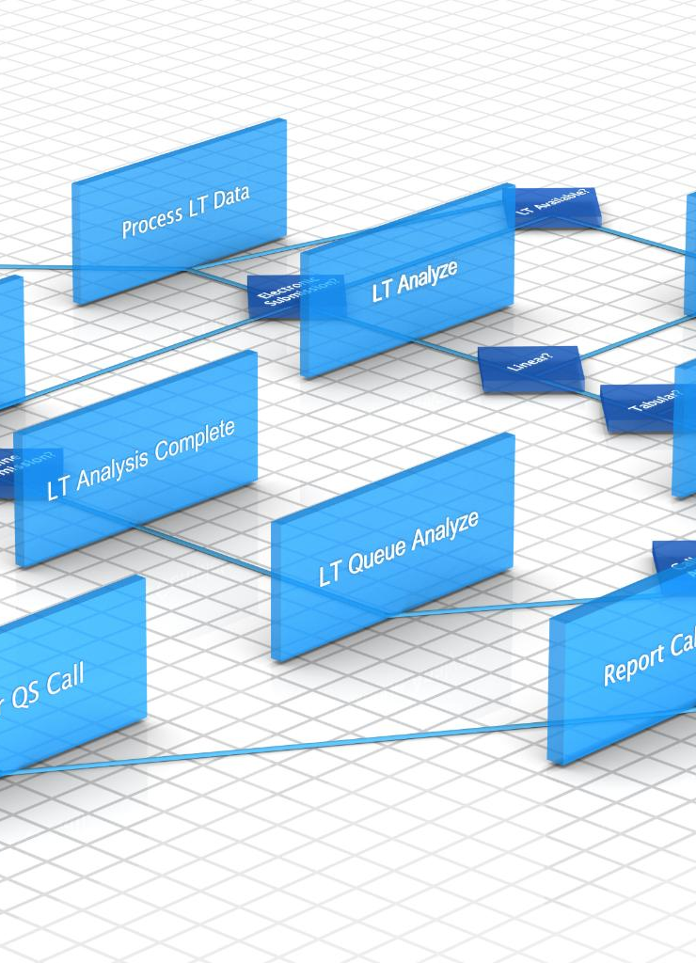
Interpreted Languages
Direct Execution
Interpreted languages execute code directly at runtime, translating it line by line as it runs.
Rapid Testing
Changes in interpreted languages can be tested quickly, allowing for faster development cycles.
Performance Trade-offs
While interpreted languages offer flexibility, they may exhibit slower performance compared to compiled languages.

Slide 5

How Interpreted Languages Work
Interpreter Functionality
An interpreter reads the source code line by line, translating it into machine code for immediate execution.
Immediate Feedback
Interpreted languages provide immediate feedback, allowing programmers to see results as they code without needing a compile step.
Execution Speed
While interpreted languages offer immediate execution, they may result in slower performance compared to compiled languages.

Slide 6


How Interpreted Languages Work
High-Level Language Program
Machine Language Program Statement
void main()
{
string name;
cout << “Enter your name: “;
cin >> name;
cout << “Welcome to the world …
}
Interpreter
000000 00001 00010 00110 00000 100000
Main Memory
Interpreter Functionality
An interpreter reads the source code line by line, translating it into machine code for immediate execution.
Immediate Feedback
Interpreted languages provide immediate feedback, allowing programmers to see results as they code without needing a compile step.
Execution Speed
While interpreted languages offer immediate execution, they may result in slower performance compared to compiled languages.
Central Processing Unit (CPU)

Slide 7

Compiled Languages
Definition of Compiled Languages
Compiled languages convert source code into machine code before execution, enhancing performance significantly.
Performance Benefits
By converting to machine code ahead of time, compiled languages eliminate the need for runtime interpretation, resulting in faster execution.
Limitations
Different compilers are required for different computing platforms since the machine code is different for each platform. This requires that source code be compiled for each unique computing platform.

Slide 8

How Compiled Languages Work
Compilation Process
The compilation process involves translating source code into machine code using a compiler, creating an executable file.
Executable File
The resulting executable file can run independently of the original source code, enhancing usability and distribution.
Performance Benefits
Compiled programs typically offer better performance and efficiency compared to interpreted languages, due to direct execution of machine code.

Slide 9
How Compiled Languages Work
Machine Language Program
void main()
{
string name;
cout << “Enter your name: “;
cin >> name;
cout << “Welcome to the world …
}
000000 00001 00010 00110 00000 100000
100011 00011 01000 00000 00001 000100
000010 00000 00000 00000 10000 000000
…
Compiler
High-Level Language Program
Compilation Process
The compilation process involves translating source code into machine code using a compiler, creating an executable file.
Executable File
The resulting executable file can run independently of the original source code, enhancing usability and distribution.
Performance Benefits
Compiled programs typically offer better performance and efficiency compared to interpreted languages, due to direct execution of machine code.
Main Memory
Central Processing Unit (CPU)

Slide 10

Java Uses a Hybrid Approach
Hybrid Compilation and Interpretation
Java's unique approach combines both compilation and interpretation, enhancing its versatility in software development.
Bytecode and JVM
Java code is compiled into bytecode, which is portable and can be executed by the Java Virtual Machine across different devices.
Platform Independence
Java's architecture enables platform independence, allowing applications to run on any device that supports the JVM.

Slide 11
How Java Works
Compilation Process
Java source code is compiled into bytecode by the Java compiler, making it platform-independent.
Execution by JVM
The Java Virtual Machine (JVM) executes the bytecode, interpreting it for the specific hardware and operating system.
Portability
Java's architecture ensures portability across different platforms by translating bytecode into machine code for each system.

Slide 12



How Java Works
Java Source Code
Java Bytecode
public class MyJavaProgram
{
public static void main( String [] args )
{
System.out.println(“Go Java”);
}
}
Java Compiler
Can be executed by any Java Interpreter
Java Interpreter
Java Interpreter
Java Interpreter
Same code can be run on any computer that implements Java
CPU
CPU
CPU

